Slide 1
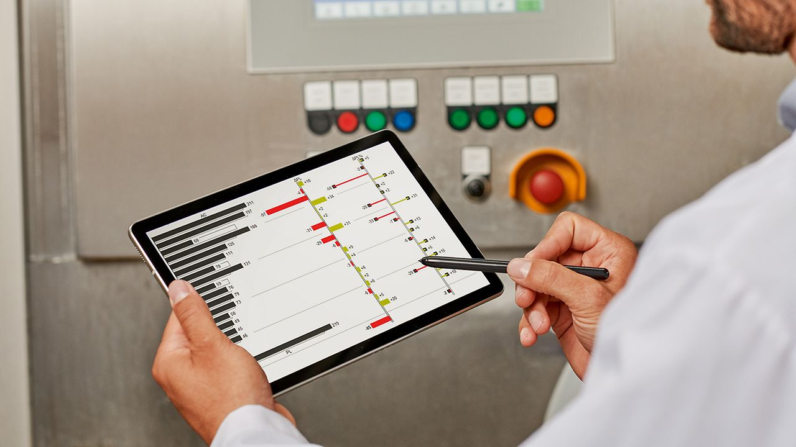
CAMARA QoD – AVP Use case
287185920
232633200
233788448
57469760
290671632
230249104
230249104

Slide 2
Components of 5G network with exposure
Client Application
Business Application
Examples:
get information about quality of radio link
set quality of service (QoS) requirements
UE/Devices
Server or Cloud
4G/5G Spectrum
API Gateway (Security, Policies, …)
RAN
Service Enabling Function(s)
Mostly use case specific
4G/5G Core
Service Enabling Function (4G) / Network Exposure Function (5G) (SCEF/NEF)
IP Network

Slide 3
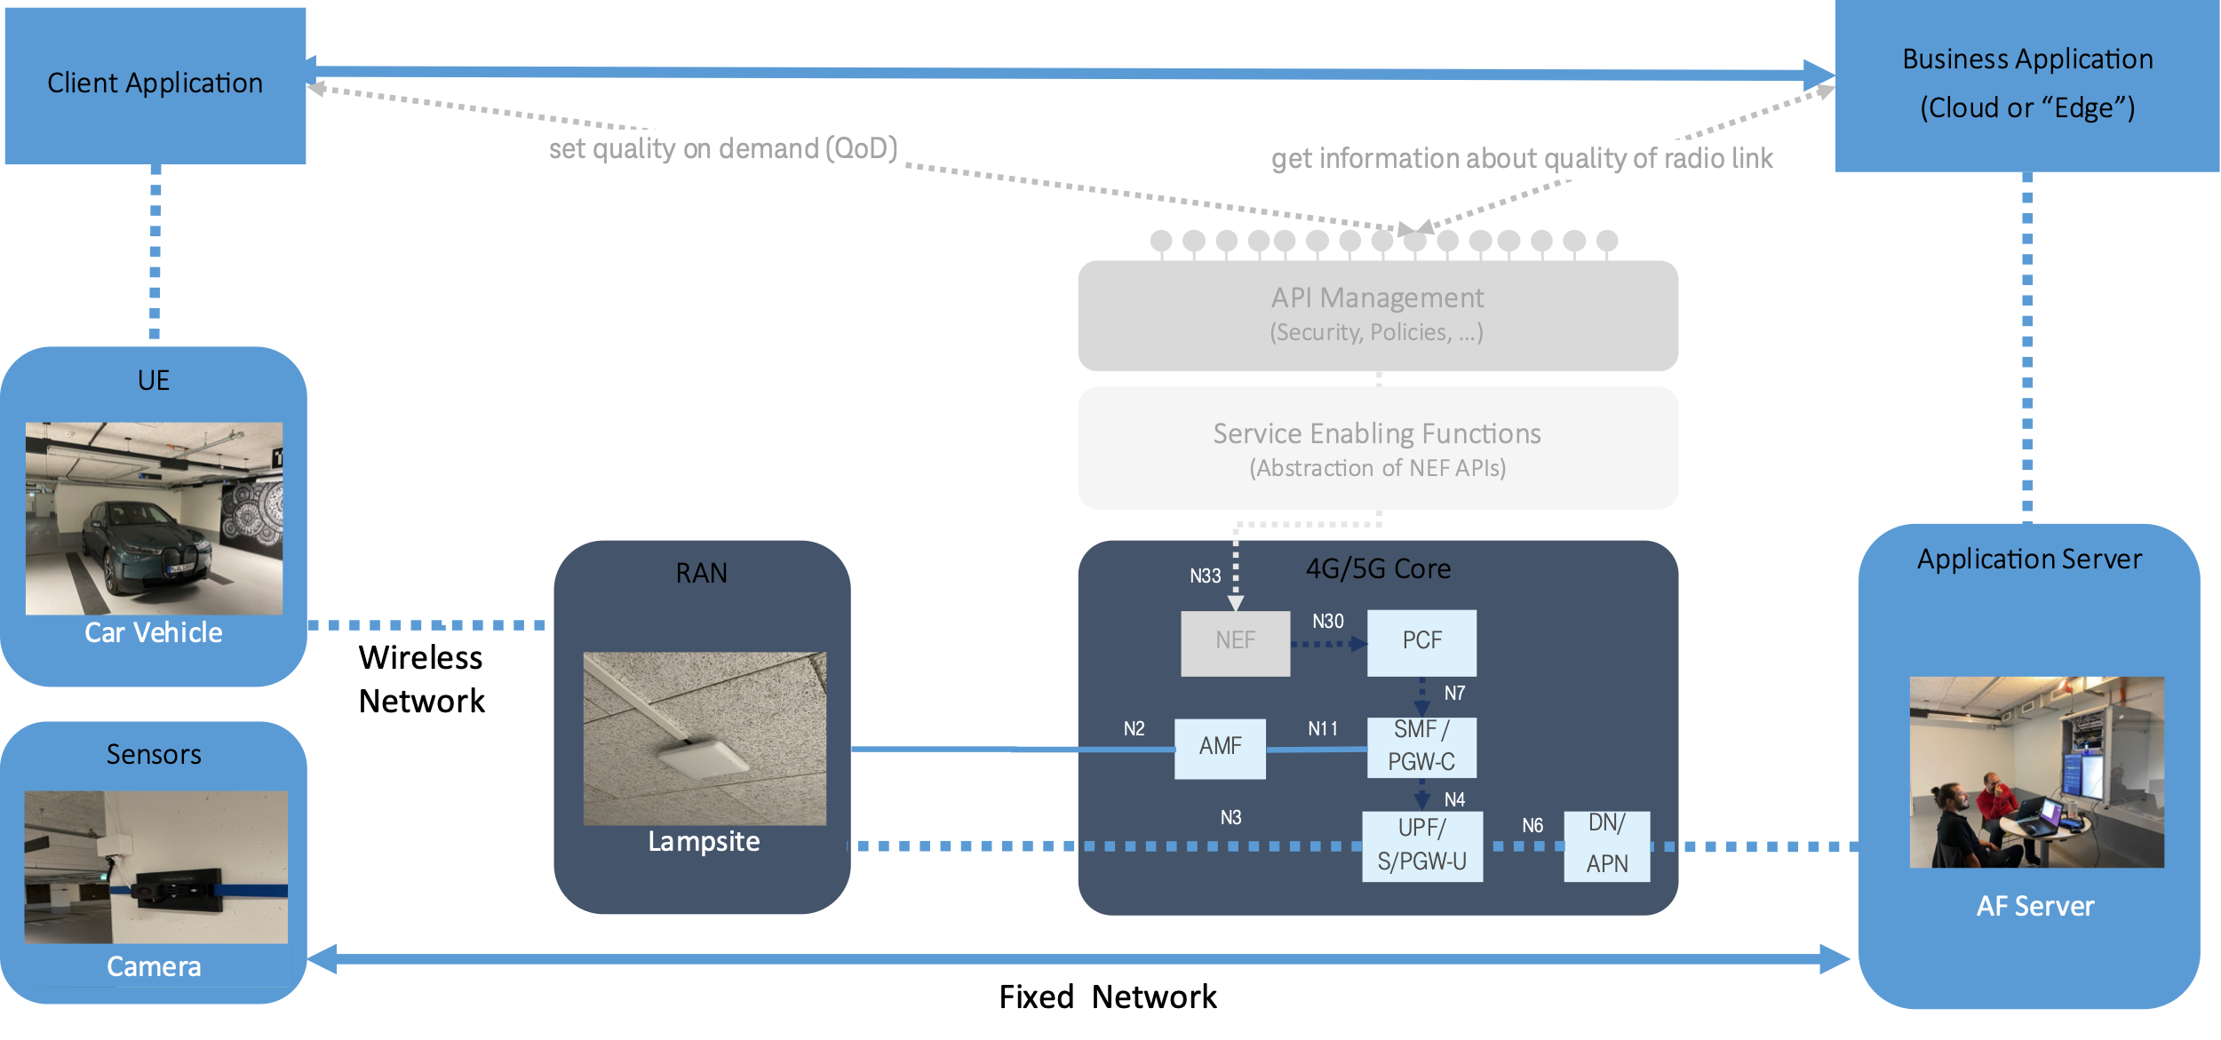
AVP – TARGET Architecture

